Slide 1
Vitamin D and Prostate Cancer
William B. Grant, PhD
Sunlight, Nutrition and Health Research Center
San Francisco

Slide 2
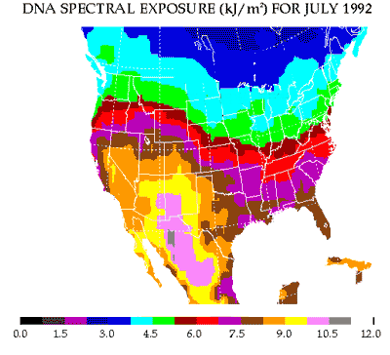
Solar UVB Dose at the Surface Using NASA Satellite Instrument Data

Slide 3
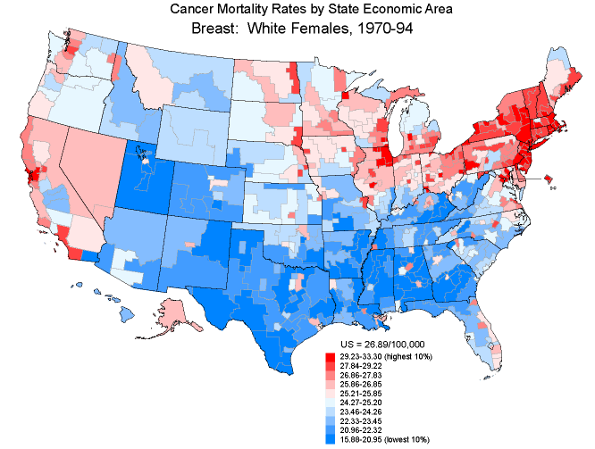
Breast Cancer Mortality Rates,
White Females, 1970-94

Slide 4

Prostate Cancer Mortality Rates,
White Males, 1970-94

Slide 5
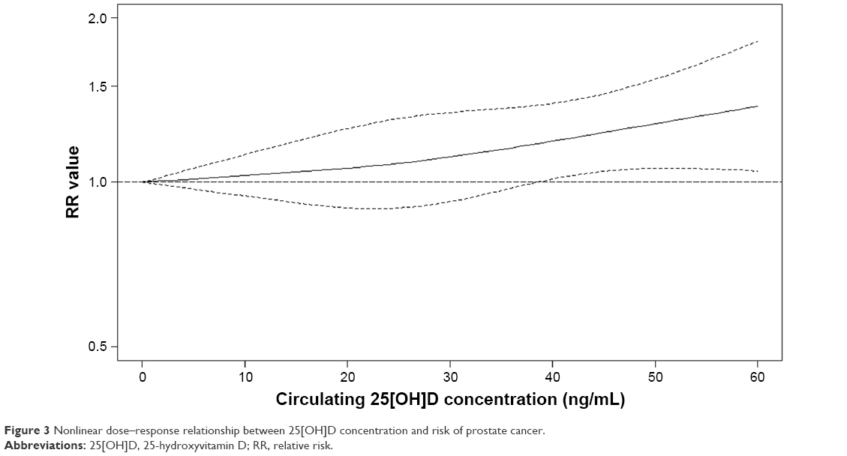
Circulating vitamin D concentration and risk of prostate cancer: a dose-response meta-analysis of prospective studies
Gao, Ther Clin Risk Manag
. 2018 Jan 9;14:95-104.

Slide 6
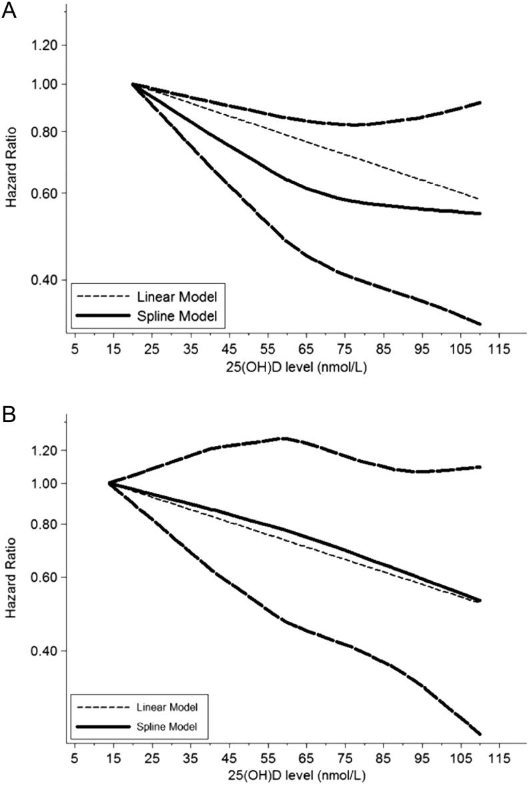
Circulating vitamin D level and mortality in prostate cancer patients: a dose-response meta-analysis
Endocr Connect.
2018;7(12):R294-R303.

Slide 7
Calcium and phosphorus intake and prostate cancer risk: a 24-y follow-up study
Calcium intakes >2000 mg/d were associated with greater risk of total prostate cancer and lethal and high-grade cancers. These associations were attenuated and no longer statistically significant when phosphorus intake was adjusted for. Phosphorus intake was associated with greater risk of total, lethal, and high-grade cancers, independent of calcium and intakes of red meat, white meat, dairy, and fish. In latency analysis, calcium and phosphorus had independent effects for different time periods between exposure and diagnosis. Calcium intake was associated with an increased risk of advanced-stage and high-grade disease 12-16 y after exposure, whereas high phosphorus was associated with increased risk of advanced-stage and high-grade disease 0-8 y after exposure.
Wilson et al. Am J Clin Nutr. 2015;101(1):173-83

Slide 8
MUSC Prostate Cancer
Intervention Trial
Stage 1 Prostate Cancer Patients, PSA < 10 and Gleason Score <6.
These Guys are Watch and Wait.
One Year Trial Getting 4,000 IU/d Vitamin D₃.
PSA was Measured.
Prostate Biopsy at Diagnosis and Upon Exiting the Study.

Slide 9
Positive Cores at Repeat Biopsy

Slide 10
Percent of Prostate Cancer Subjects with Increase in Positive Cores at Repeat Biopsy

Slide 11
Publication
Vitamin D3 supplementation at 4000 international units per day for one year results in a decrease of positive cores at repeat biopsy in subjects with low-risk prostate cancer under active surveillance.
Marshall DT, Savage SJ, Garrett-Mayer E, Keane TE, Hollis BW, Horst RL, Ambrose LH, Kindy MS, Gattoni-Celli S.
J Clin Endocrinol Metab. 2012;97(7):2315.

